Slide 1
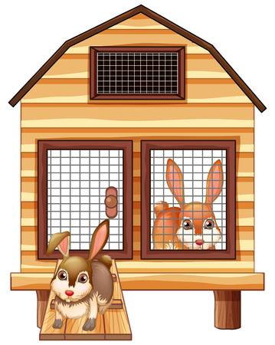
bunny hutches
The yard behind the school has some bunnies and some bunny hutches. If 8 bunnies move into each hutch, one bunny will be homeless. When one hutch is empty, there are 11 bunnies in each of the other hutches. How many bunnies and how many hutches are in the yard? How do you know?

